Slide 1
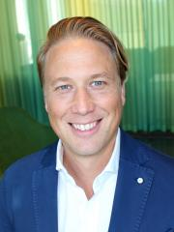
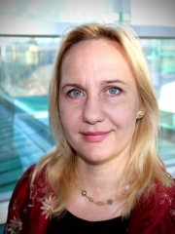
Eric Westman: ”Brain imaging in Alzheimer´s disease and other neurodegenerative disorders: implications for diagnosis and treatment” Dorota Religa: ”Dangerous interplay between dementia and frailty in older adults”
Division of Clinical Geriatrics,dept NVS
Has the pleasure to invite you to an afternoon with lectures
by our newest professors
Eric Westman and Dorota Religa
Date: January 20th
Time: 14.00-16.00
Zoom:https://ki-se.zoom.us/j/69664974802
PROGRAM
14.00 – 14.05 Welcome by NVS prefekt Maria Ankarcrona
14.05 – 14.50 Introduction by professor Lars-Olof Wahlund, Division of Clinical Geriatrics.
Lecture by Eric Westman
14.50 – 15.00 Intermission
15.00 – 15.45 Introduction by professor Maria Eriksdotter, Division of Clinical Geriatrics.
Lecture by Dorota Religa
15.45 - 16.00 Closing remarks

