Slide 1
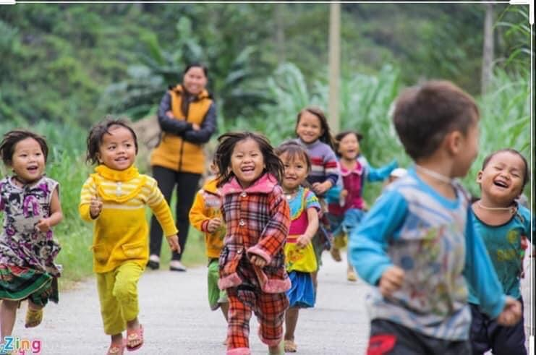
Child health in Vietnam – history, present and future perspectives
Hang Tran
Global Child Health & SDGs team
August 25, 2022

Slide 2
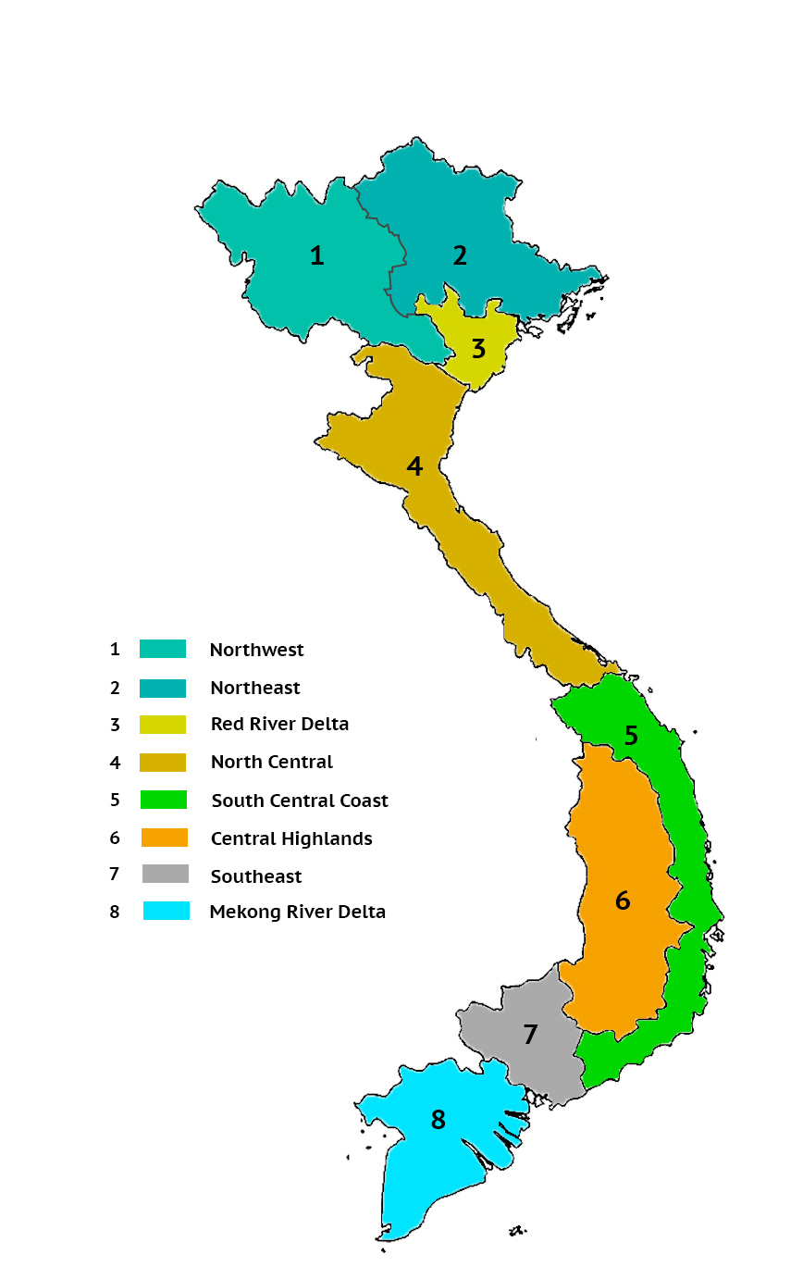
Vietnam – fast facts
Notes:
Vietnam is one of the most populous countries in the Asia Pacific region, with an estimated population of nearly 97 million inhabitants. Hanoi, the state’s capital, is among the most-populated cities in the country, with Ho Chi Minh City leading the field. Vietnam has a low urbanization rate, with many of its residents living in a rural areas and working in agriculture
Vietnam has made significant progress in improving the population’s health parallel to its economic development. An average Vietnamese could now expect to live to 75 years, compared to 70 years in the 1990s. This is relatively high compared to countries with similar GDP per capita. As people live longer, both the public and private sectors have been striving to meet the population’s growing healthcare demands. For example, the number of hospitals in Vietnam is rising fast, especially in the number of private facilities.

Slide 3
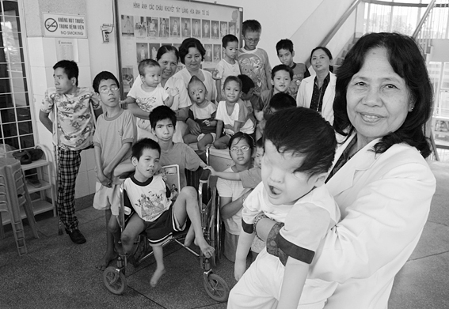
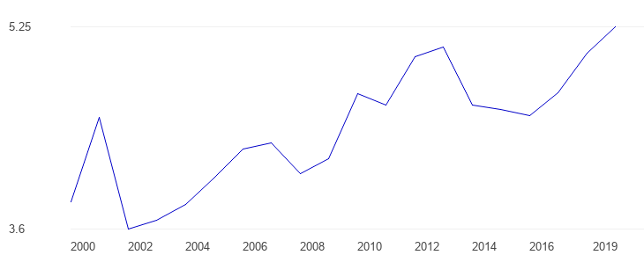
History of the healthcare system
1945 to Vietnam War (1955 – 1975)
Medical university in Viet Bac war zone (1949)
Hospital Admissions: battle injuries and malaria
Post-war (1976 – 1980)
Lact of funds and qualified physicians
Health impacts in Vietnamese veterans (agent orange)
Renovation (1980s – now)
Increase GDP in healthcare spending (1.1%)
Black markets in medicine
Provide free basic health care
Introduce new healthcare reforms
Three cleans movement and three exterminations movements
Notes:
Nhờ những cố gắng, nỗ lực của ngành Y, y tế nông thôn ở miền Bắc trong thời kỳ này đã có những thay đổi rõ rệt. Số bệnh viện được đầu tư xây dựng ở miền Bắc, từ 57 bệnh viện, 17 bệnh xá năm 1955 lên thành 442 bệnh viện và 645 bệnh xá năm 1975. Số lượng cán bộ ngành y cũng tăng nhanh từ 108 bác sĩ năm 1955 lên 5.684 bác sĩ năm 1975
Hệ thống y tế được mở rộng, xây mới và áp dụng tiến bộ khoa học kỹ thuật. Số giường bệnh thuộc các cơ sở y tế tăng từ 89,4 nghìn giường năm 1976 lên 114,7 nghìn giường năm 1985. Số nhân viên y tế tăng từ 110,9 nghìn người năm 1976 lên 160,2 nghìn người năm 1985, trong đó số bác sĩ tăng từ 9.104 người lên 19.029 người.

Slide 4
Healthcare system organization
Other ministries’ health facilities:
Military
Police
Transport
Construction
Post-office…
National
level
63 provinces
708 districts
11,162 communes
MOH
National general and specialist hospitals
Research institutes
Medical universities
Population: 1-2 millions (average)
Provincial Health Departments
Provincial hospitals
Preventive health center
Medical colleges
Private sector:
~ 200 hospitals
8,000 beds (0.9 per 100,000 habitants)
> 35,000 clinics
Population: 100,000 – 200,000 (average)
Health Offices
Distric hospitals/centers
Primary health
Population: 5,000 – 10,000 (average)
Commune Health Centers
Village Health Workers
Notes:
Vietnamese healthcare systems are in the process of reforming and developing, focusing on: effectiveness, equity and quality

Slide 5
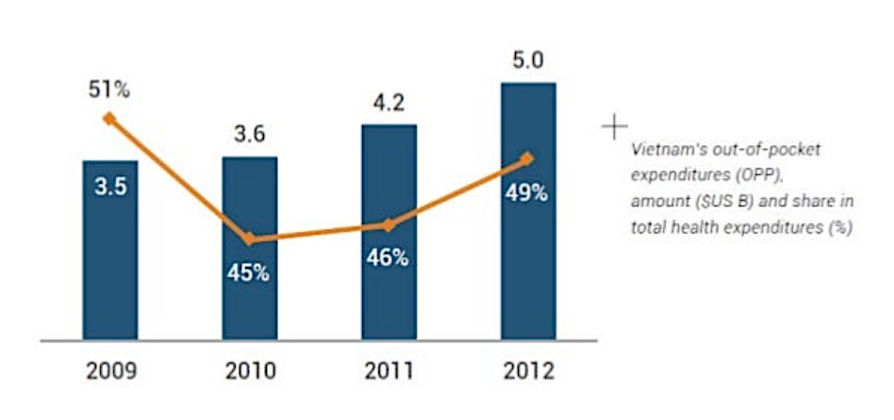
Health financing in Vietnam
Social Health Insurance: MUST have lower-level hospital referrals
Health care funds for the poor policy
High rate of out-of-pocket payments

Slide 7
Notes:
In 2021, the North Central and Central coastal areas had the highest number of public patient beds at 69.3 thousand. The region also had the highest number of non-public patient beds at 9.2 thousand in Vietnam. In the same year, there were 307.7 thousand public and 27.4 thousand non-public patient beds in Vietnam in total.

Slide 8
Healthcare workers
Notes:
Vietnam is facing a critical shortage of healthcare manpower. Currently Vietnam has 7.6 doctors per 10,000 people. There is a wide disparity in the doctor per people ratio. In cities like Hanoi and HCMC, the rate is about 9 doctors per 10,000 people but in remote areas this number is as low as 1.

Slide 9
Notes:
In 2021, there were around 11 doctors per ten thousand inhabitants in Vietnam.

Slide 10
Trends of population proportion (1989 – 2050)

Slide 11
Under 5 mortality rate in Vietnam (1964 – 2020)
Notes:
Review for Millennium Development Goals, Viet Nam was recognised by global community as a bright spot in achieving the goals of maternal and child health indicators. During 15 year of MDGs implementation, the mortality rate of children under five years old (U5MR) in Viet Nam declined by more than 60%, dropping from 58 to 22.1 deaths per 1,000 live births between 1990 and 2015, lower than the global figure

Slide 12
Rural area
Urban area
North
mount
Central
highland
South
east
Red river
Delta
Notes:
There is also a big difference (nearly 3 times) in U5MR between mountainous, remote, and ethnic minority areas compared to urban and delta areas of Viet Nam. Also according to the latest 2019 census data (4), the U5MR in rural areas was 25.1‰ that was almost 2 times higher than in urban areas (12.3 ‰). At the regional level, the U5MR in the Northern mountainous provinces (31.5‰) and the Central Highlands (35.5‰) were nearly three times higher than in the Southeast (12.7‰) and twice as much as that in the Red River Delta region (16,5‰). Therefore, priority interventions should focus on disadvantaged, mountainous and ethnic minority areas. Reduce the gaps in child health care between regions, wealth quintiles and ethnic groups can lower U5MR nationwide.

Slide 13
Neonaltal mortality rate in Vietnam (1974 - 2020)
Notes:
Although the neonatal mortality (NMR) has decreased significantly compared to the previous decade, the proportion of NMR still contributes to a major part of U5MR. According to the Maternal and Child Health Department's annual report, NMR currently accounts for more than 70% of infant deaths and more than 50% of under-5 deaths (6). Compared with other countries in the world, the number of neonatal deaths in Viet Nam is in the group with a high proportion of total under five deaths.

Slide 14
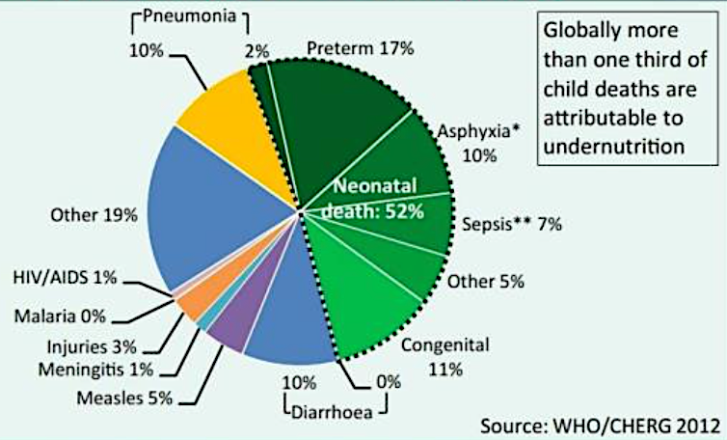
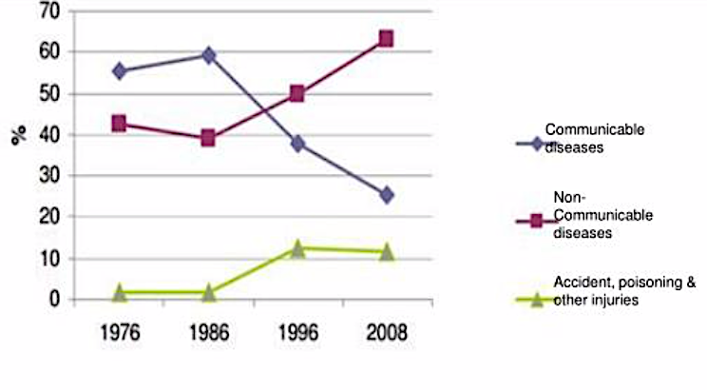
Cause of death
A shift toward NCD
Notes:
The common cause of deaths of under 5 children has not changed much compared to the previous period. The majority of deaths occurs in neonatal period. the main causes of death are respiratory, circulatory diseases, infections and birth defects

Slide 15
Accidents, injuries and reoccurrence of some infectious diseases can be prevented with vaccination
Measles epidemic in 2013 – 2014:
> 4000 children infected
> 100 children under 5 years old died
2019: 14,000 cases nationwide
Diphtheria epidemic reappear (2019)
53 cases in 7 provinces
5 died
Accidents and injuries: 20-25% of the total deaths of children under 5 years old including: Drowning; Traffic accidents and accidents occurred at home (food chopping, falls, poisoning, electric shock, burns
1,634 children under 5 years old died in 2013

Slide 16
Influencing factors for childhealth system

Slide 17
Pediatric hospital network

Slide 18
Human resourse
0.6 pediatrician/10,000 children < 16 years
Discontinuation of pediatric training since 1998
Uneven distribution of human resourses
Quality of training program

Slide 20
Summary of the current vietnamese childhealth system
Sparse network of pediatric care is unable to fully support local health providers or provide adequate care for children nationwide
Overloading and uneven distribution of resources between lower level and regions (geographic and/or socio-economic)
Missing latest evaluation and statistics on child health’s need
Healthcare policies, systematical management and investment
Modest wage and employment benefic package for public hospitals workers
Lack of strategies and policies to retain highly skilled employees
Under pressure from the community because of many limitations in the field

Slide 21
Direction towards SDGs 2030 and more
Effectiveness
Equity
Quality
Community oriented
Development
Notes:
The results of many studies confirm that countries can reduce child mortality by more than half with simple, inexpensive and feasible interventions even in the limited resourced settings.
The interventions to reduce child mortality should prioritize for the most vulnerable groups, in areas with a high rate of child mortality in order to accelerate the rate of mortality reduction, narrowing the gap in health care, ensuring equity in child healthcare. If this can be done, it is certain that U5MR will be reduced, thus helping Viet Nam in sustaining the achievements in the MDGs, and striving for SDGs by 2030

Slide 22
Interventions to reduce neonatal mortality
Anternatal care
Early essential maternal and newborn care
Kangaroo mother care for VLBW and ELBW
Emergency care and timely care of sick newborns
Improve knowledge & practice for primary health staff
Notes:
Viet Nam has also been and continues to adopt a continuum of care approach in interventions reducing NMR. Close coordination of interventions at home and community together with safe referral care and efforts to improve the quality of neonatal care at health facilities is considered a best solution to reduce NMR. These measures are considered as a crucial strategy to achieving the goal of reducing neonatal mortality.

Slide 23
Interventions to reduce under five mortality
Prevention: immunization
Pediatric emergency, safety in patient transport
Enhancing treatment at all level of health facilitites
Connecting communities and health facilities
Proactive disaster preparedness and timely responses
Notes:
Building a network to child health care from families, communities to health facilities; Support safe referral; set up the communication system from lower to higher levels for consultation and guidance on disease management; Always coordinate the prevention and with treatment system in child health care; Building the link and support each other between public health and private health facilities.
One more point should be noted that Viet Nam is one of 5 coastal developing countries in the world that are most affected by climate change and the dangers of it are unpredictable. Therefore, it is necessary to have proactive disaster preparedness and timely responses to reduce risks to the health of the people in general and children in particular. National strategies on health care need specific plans to provide the most basic needs when the disaster occurs.

Slide 24
Expanding pediatric care network
Narrowing the disparity in health among regions
Broadening pediatric health network in remote areas and for minority groups
Appointing doctors to work in underserved areas
Targeted ratio of 1 doctor per 1,000 children for primary care
Developing/eccelerating the development of community pediatric program:
IMCI
APLS/NLS

Slide 25
Pediatric staff training
Pediatric branch provide training for pediatric system
Provide adequate pediatric health workers supply for pediatric hospitals according to population size, geographical and economic features
Training programs:
Formal training programs: post-graduate training, resident doctors, specialist program
Continuous training: specialty training, module training, technology transfer
Cooperative training programs with other medical centers and universities nationwide and internationally.

Slide 26
Thank you for your attention

