Slide 1
Research priorities in neonatal, child, and adolescent health across different research areas in Low and middle-income countries: A scoping review.
Valentina Arcos Elgueta
Main Supervisor: Dr. Carina King
Co-supervisor: Dr. Olivia Biermann
Half time Report, Degree project in global health
Karolinska Institutet

Slide 2
Background
Over the last 30 years, mortality in children under 5 years of age has decreased but the global burden of deaths among neonates and children remains significant.
Sustainable Development Goals (SDGs) aim to promote healthy lives and wellbeing for all children.
In 2014, there were 1.2 billion adolescents aged 10-19 years old, comprising 16.4% of the world’s population. Adolescent mortality was estimated at 1.3 million in 2012
The great majority of the world’s adolescents live in low- and middle-income countries (LMICs)
It is important to be able to identify priorities in neonatal, child and adolescent health that are representative of the global situation in order to develop an agenda for research.

Slide 3
Aim
Research Questions
To identify and synthesize research priorities in health identified from existing research prioritization exercises relevant to neonates, children, and adolescents in Low and Middle-Income Countries (LMICs), and find commonalities to set global health prioritized research agendas, aiming to focus future research, funding, and stakeholder's efforts.
What areas of research have been prioritized in neonatal, child, and adolescent health in LMCs in the last 10 years?
Are there overlaps and commonalities in research priorities being set for different causes of morbidity and mortality in the different age groups of interest?

Slide 4
Methods and preliminary results
Scoping review
Methodological framework developed by Arksey and O´Malley for scoping reviews is used to conduct this scoping review.
PRISMA extension for scooping reviews (PRISMA-ScR) will be used as a reporting
KI library team developed the search strategy, searched in MEDLINE and WEB OF SCIENCE.
Included / excluded articles: study selection criteria and Rayyan program
Articles will be charted and recorded in an Excel file before its analysis
No especial ethical considerations are needed
Keywords:
Research priority, CHNRI, Delphi, Child, Neonate, Adolescent, Health.

Slide 5
Criterias
Inclusion Criteria
Exclusion criteria
1.Research priorities include those for:
neonatal (0-28 days),
child (1 month- 9 years),
and adolescent (10-18 years) health.
2.Setting priorities for health research
3.Published between 2011 and 2021
4.(CHNRI) or DELPHI priority setting consensus method
4.Focused on LMICs
5.Research written in English.
1.Not using a CHNRI/DELPHI approach.
2.Doesn’t focus on neonates, children, and/or adolescent health
3.Doesn’t set priorities for research
4.Doesn´t focus on LMICs
5.Research published before 2011
6.Commentaries articles.
7.Expert Overview of a topic
8.Full text not available online

Slide 6
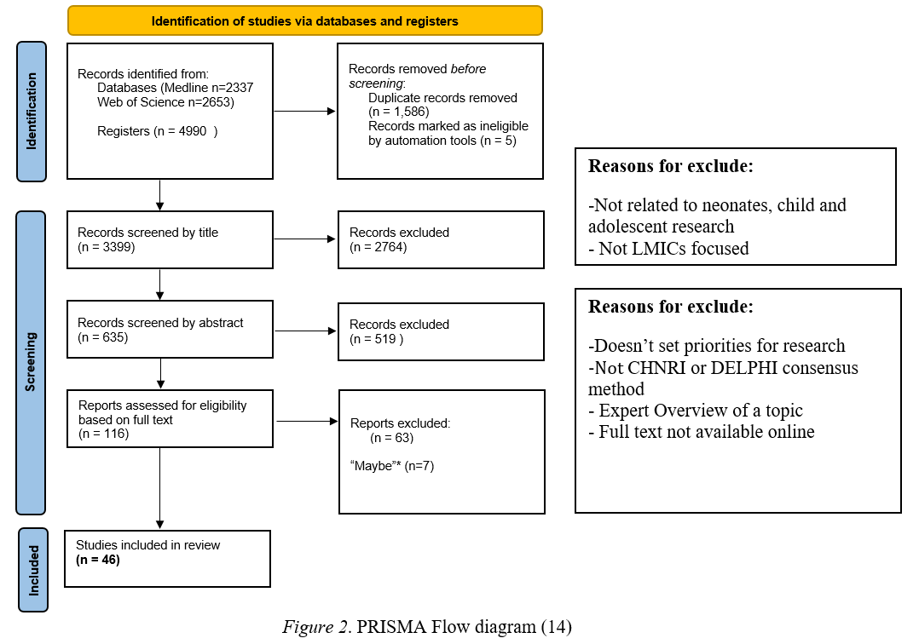
Methods and preliminary results
*
Bramer method: “De-duplication of database search results for systematic reviews in EndNote”
*

Slide 7
References
1. Munn, Peters, M. D. J., Stern, C., Tufanaru, C., McArthur, A., and Aromataris, E. (2018). Systematic review or scoping review? Guidance for authors when choosing between a systematic or scoping review approach. BMC Medical Research Methodology, 18(1), 143–143. https://doi.org/10.1186/s12874-018-0611-x
2. Armstrong R, Hall BJ, Doyle J, Waters E. ‘Scoping the scope’ of a Cochrane review. J Public Health. 2011;33 (1):147–50.
3. Rebecca Armstrong, Belinda J. Hall, Jodie Doyle, Elizabeth Waters, ‘Scoping the scope’ of a cochrane review, Journal of Public Health, Volume 33, Issue 1, March 2011, Pages 147–150, https://doi.org/10.1093/pubmed/fdr015
4. Hilary Arksey & Lisa O'Malley (2005) Scoping studies: towards a methodological framework, International Journal of Social Research Methodology, 8:1, 19-32, DOI: 10.1080/1364557032000119616
5. Mays N Roberts E Popay J (2001) Synthesising research evidence In N. Fulop, P. Allen, A. Clarke, & N. Black (Eds.) Studying the organisation and delivery of health services: Research methods London Routledge
6. Tricco AC, Lillie E, Zarin W, O'Brien KK, Colquhoun H, Levac D, et al. PRISMA extension for scoping reviews (PRISMA-ScR): checklist and explanation. Annals of internal medicine. 2018; 169(7):467-73.
7. World Bank Country and Lending Groups – World Bank Data Help Desk. Datahelpdesk.worldbank.org. 2021. Available from: "https://datahelpdesk.worldbank.org/knowledgebase/articles/906519-world-bank-country-and-lending-groups"
8. Black, Robert E. “The legacy of the Child Health and Nutrition Research Initiative (CHNRI).” Journal of global health vol. 6,1 (2016): 010101. doi:10.7189/jogh-06-010101

Slide 8
References
9. Rudan I. Setting health research priorities using the CHNRI method: IV. Key conceptual advances. J Glob Health. 2016;6(1):010501. doi:10.7189/jogh-06-010501
10. Dalkey, NC (1969) The Delphi Method: An Experimental Study of Group Opinion. Santa Monica, CA: Rand.
11. Jorm AF. Using the Delphi expert consensus method in mental health research. Australian & New Zealand Journal of Psychiatry. 2015;49(10):887-897. doi:10.1177/0004867415600891
12. Bramer, W. M., Giustini, D., de Jonge, G. B., Holland, L., & Bekhuis, T. (2016). De-duplication of database search results for systematic reviews in EndNote. Journal of the Medical Library Association: JMLA, 104(3), 240–243. doi:10.3163/1536-5050.104.3.014
13. Mourad Ouzzani, Hossam Hammady, Zbys Fedorowicz, and Ahmed Elmagarmid. Rayyan — a web and mobile app for systematic reviews. Systematic Reviews (2016) 5:210, DOI: 10.1186/s13643-016-0384-4.
14. BMJ (OPEN ACCESS) Page MJ, McKenzie JE, Bossuyt PM, Boutron I, Hoffmann TC, Mulrow CD, et al. The PRISMA 2020 statement: an updated guideline for reporting systematic reviews. BMJ 2021;372:n71. DOI: 10.1136/BMJ.n71
15. Booth A, Maddison J, Wright K, Fraser L, Beresford B. Research prioritisation exercises related to the care of children and young people with life-limiting conditions, their parents and all those who care for them: A systematic scoping review. Palliat Med. 2018;32(10):1552-1566. doi:10.1177/0269216318800172

