Slide 1



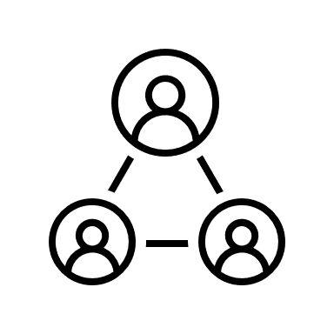
Usability of five pulse oximeters used for children under five in a community setting
A cross sectional study in Cambodia, Ethiopia, South Sudan and Uganda
16.03.2022
Theresa Pfurtscheller, Degree project Global Health, Karolinska Institutet, Supervisor Kevin Baker, Co-Supervisor Tobias Alfvén
Notes:
The topic of my thesis is usability of five pulse oximeters used for children under five in a community setting
This is an observational study set in Cambodia, Ethiopia, South Sudan and Uganda
I will start with some background information on child mortality and the importance of LRI in child health, then I will present my study aim and research questions. I will explain the design of the study, important methodological considerations and then we will finish with the planned analyses

Slide 2
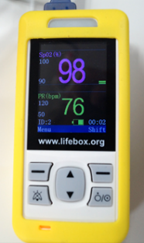
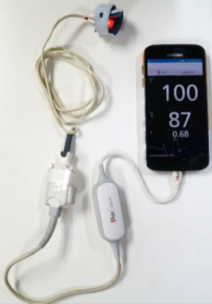
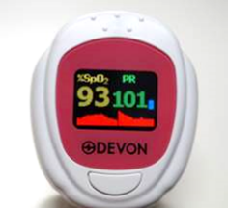
AIM
The study aims to describe the usability of five pulse oximeter devices when used for children under 5 in a community setting in low- and lower middle-income countries by determining effective use, satisfaction and error rates.
Fingertip device
Handheld device
Handheld device/phone
Notes:
The Aim of this study is to describe the usability of five pulse oximeter devices when used in a community setting and to understand the acceptability of these devices among CHWs in low-income and lower-middle income countries
The expected results of this study on the usability and acceptability will then be useful for public health officials planning scaled use of pulse oximetry on community level because they provide an overview of the advantages and challenges of it in routine communtiy settings
These are my two research questions focusing on usability and acceptability, since it is a mixed methods study I am using one question for the quant part and one for the qual part

Slide 3
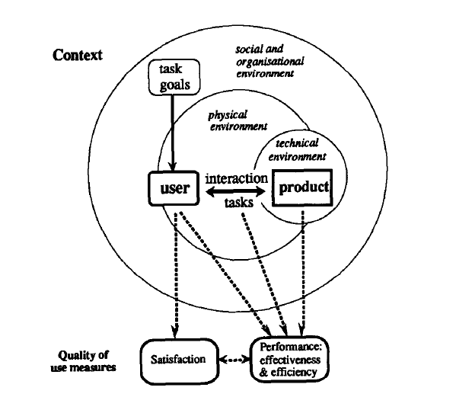
Framework
Effectiveness
Task completion rate (reported as combined value)
Additionally reports on negative consequences
Efficiency
Time controlled measurement
Can also be defined through a fixed number of tries
Satisfaction
Subjective measurement
Includes perceptions of use and attitudes towards a product
Measuring Usability as Quality of Use (Bevan 1995)
Notes:
Because usability cannot be measured directly and definitions are not universal I have chosen this framework to guide my methodology and the analysis plane
This framework takes a human factor oriented approach that takes into account the situation and context of the use. This is appropriate for this study especially because we are not testing usability as part of a design process of a product but rather test usability of an existing product within a new context.
Users: CHWs, FLHFWs
Task goals: Taking a pulse oximeter measurement in children <5 with fb and filtering out the severely ill
Context: community health context (describe the healthworkforce and the settings)
Product: 2 fingertip devices, 2 handheld units, 1 handheld phone oximeter
Performance has been examined, I therefor focus on effectiveness, efficiency and satisfaction within a routine work context

Slide 4
Research Questions
How effectively can CHWs and FLHFWs in their routine settings in Cambodia, Ethiopia, South Sudan and Uganda use five pulse oximeters as a screening tool for severe illness in children under 5?
How frequent are errors during the use and subsequent diagnostic steps when using pulse oximeter devices as a screening tool for severe illness in children under 5 by CHWs and FLHFWs in the respective countries?
How satisfied are CHWs and FLHFWs from the respective countries with these five devices within their context?
Which factors influence the satisfaction and effective use of the five pulse oximeter devices in a community health setting?

Slide 5
Hypotheses
Conceptual hypothesis
The type of device, educational level and experience of the health worker and the age of the child influence effective use of and satisfaction with pulse oximeters in a community health context.
Operational hypotheses
Fingertip devices are easier to use and more acceptable to Health Workers in a Community Setting.
Lower educational level and less experience of the Health Worker have a negative impact on effective use.
Within the younger age group, children <1 year, devices with multiple probes are used more effectively than single-probe devices.

Slide 6





Data collection & Sampling
Orally
administered
Questionnaire
72 CHW
17 FLHFW
Pulse oximeters were used if fast breathing was detected
Total of 316 observations (262 through CHW, 54 through FLHFW)
Notes:
Data collection:
Data was collected and is provided to me through the NGO Malaria consortium. A purposive sampling strategy was used where CHW and FLHFW who had taken part in a previous multicentre observational performance study and had completed a 2 day training course were invited to participate
They were observed 3 times over the course of 3 months, 5 assessments on children under 5 were taken, this represents a convenience sample of children that presented to the HW on that day. After the end of the observational phase each HW took part in a semi-structured exit interview (therefore 100 interviews) Interviews were conducted in the local languages respectively

Slide 7
Data S0urces & variables
Variable name | Type | Label
Step1 | Binary | HW used pulse-oximeter if fast breathing was detected
Step2 | Binary | HW ensured child was calm and sitting in a reclined position
Step3 | Binary | Upper & lower limb digits exposed
Step4 | Binary | HW turns device on correctly
Step5 | Binary | HW selects best fitting probe (only handheld devices)
Step6 | Binary | HW checks and cleans probe sensor (only handheld devices)
Step7 | Binary | HW connects sensor to unit correctly (only handheld devices)
Step8 | Binary | HW attaches sensor to child correctly (only handheld devices)
Step9 | Binary | HW distinguishes between Sp02 and pulse reading on display correctly
Step10 | Binary | HW records two readings
Sp02 | Sp02 classification of reading 1 “<90%”, 0 “>/=90%”
severe_pneumonia | Does the child have severe pneumonia? (Classification through HW)
referral | Was the child referred for severe pneumonia?
Satisfaction:
Likert-Scale Questionnaire on perceived usability
Exit interview questions (yes/no questions)
Contextual variables (country, cadre, education etc.)
Error, binary variable, no Pox reading could be obtained within three tries
Notes:
Here on the left you see the variables obtained from an observational checklist and another form completed by a researcher during the visit, the variables are all binary and form 10 Steps during a Pox assessment
On the right top are the variables used to assess negative consequences
For satisfaction it is not certain yet which data I will use, either if available a likert scale questionnaire on perceived usability or yes/no questions from the exit interviews
Additionally I have some contextual variables and the variable error that is recorded if no Pox measurement could be taken within 3 tries

Slide 8
Planned Analysis Usability
Effective use
Defined as task completion rate and absence of negative consequences. 10 tasks for handheld devices, 6 tasks for fingertip devices.
Presented as proportions within the following categories (Checklist Score):
At least 80% of tasks completed (>=8/10, >=5/6)
At least 50% of tasks completed (>=5/10, >=3/6)
Less than 50% of tasks completed (<5/10, <3/6)
Reports on negative consequence and overall usability aspect:
Proportion of assessments where children with Sp02<90% were correctly classified with severe pneumonia
Proportion of assessments where children with severe pneumonia were referred according to guidelines
Proportion of assessments where children with Sp02 were incorrectly classified with severe pneumonia

Slide 9
Planned Analysis Usability
Error Rates
Proportion of assessments where no pulse-oximeter reading could be obtained within 3 attempts
Satisfaction
Defined as perceived usability are assessed through orally administered survey questions. “Yes” indicates a positive attitude and perceived usability of the device.
Presented as Frequency Distribution (Satisfaction Score):
frequency distribution of number of questions answered with yes
Line chart

Slide 10
Planned Analysis Usability
Hypothesis 1: Fingertip devices are easier to use and more acceptable to Health Workers in a Community Setting.
Comparison of ranked data (Checklist Score/Satisfaction Score) btw. 2 independent groups: Mann Whitney U Test
Hypothesis 2: Lower educational level and less experience of the Health Worker have a negative impact on effective use.
Multilevel logistic regression: Checklist Score=dependent variable, education/experience of HW=independent variable, observations need to be clustered for single HWs
Hypothesis 3: Within the younger age group, children <1 year, devices with multiple probes are used more effectively than single-probe devices.
→Ordinal logistic regression: only within the age group of children<1 (113 observations), Checklist Score=dependent variable, device type (fingertip vs. handheld)=independent variable

Slide 11
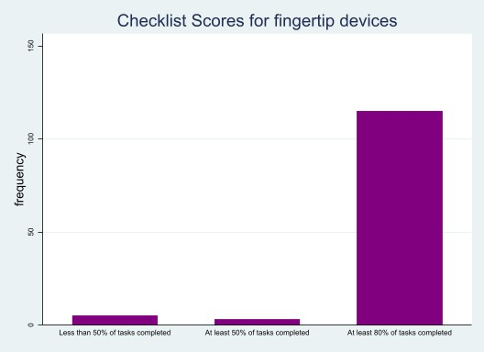
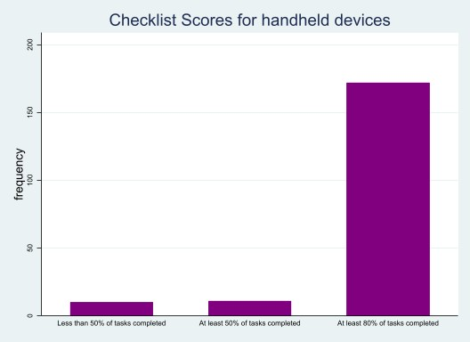
Preliminary results

Slide 12
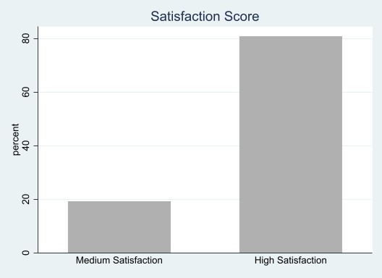
Preliminary results

Slide 13
Preliminary results

Slide 14
Thank you for your attention!

