Slide 1
Assessment of Water, Sanitation and Hygiene (WASH) in Healthcare Facilities in the Bauchi and Adamawa States of Nigeria
Implications for Cholera Control
Degree Project in Global Health
Katerina Crawford
Supervisor: Kelly Elimian

Slide 2
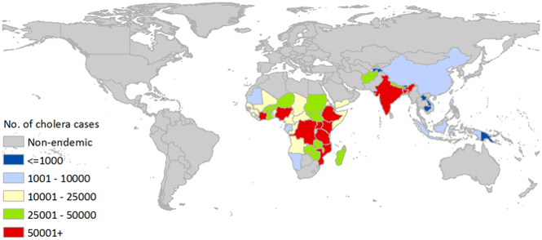
Background
PROBLEM: high levels of cholera and low WASH coverage (Nigeria)
WASH: most effective prevention for water-borne disease
Cholera: 1.3- 4 million infected/yr, 95000 die/yr
LOCATION:
Globally: Asia, Africa
Nigeria: Endemic in north, 90000 infections (2021)
IMPORTANCE:
Knowledge gap: minimal information on WASH coverage in HCF in states of interest
Disease of poverty
Global relevance: 47 countries

Slide 3
Objectives
Aim: To assess the status of water, sanitation, hygiene, waste management and environmental cleaning (WASH) services in healthcare facilities (HCF) in Bauchi and Adamawa states of Nigeria and understand the characteristics associated with the availability of these services.
RQ:
1. What is the availability of WASH services in healthcare facilities in Bauchi and Adamawa states?
2. What characteristics are associated with the availability of WASH services in healthcare facilities in Bauchi and Adamawa states?

Slide 4
Methods
Study design:
Cross-sectional quantitative (March 8-30, 2021)
Study size:
120 HCF (52 rural, 54 urban, 14 peri-urban)
Study setting:
Bauchi: 6,537,300 (2016), 61.5% poverty
Adamawa: 4,248,400 (2016), 75.4% poverty
NE Nigeria: 22,606 cholera cases (51%) (2018)
Data collection:
3 research assistants (2 days/HCF
Open data kit (ODK) app
Health facility survey: WHO Core questions and indicators for monitoring WASH in HCF & WHO SARA
Sampling strategy:
Purposive stratified
Ethics
Approved by Nigeria National Health Research Ethics Committee

Slide 5
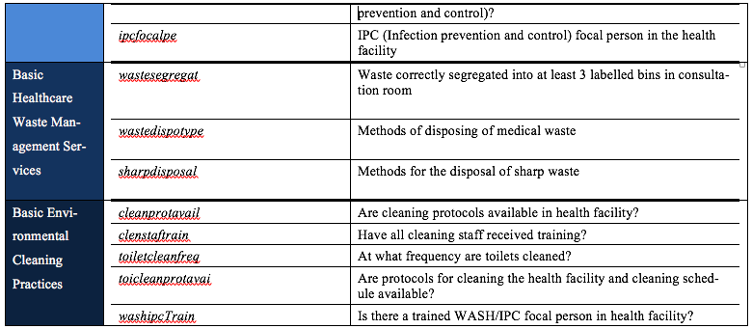
Variables
Table 1: Sub-variables in health facility survey and STATA coding
Independent variables:
Facility type (primary, secondary, tertiary, camp for internally displaced persons)
Facility ownership type (public, private-for-profit, NGO)
Health facility setting (rural, peri-urban, urban)
Catchment area is a cholera hotspot (yes, no)
Dependent variables:
Basic water services
Basic sanitation services
Basic hygiene services
Basic healthcare waste management services
Basic environmental cleaning practices

Slide 6
Analysis
Objective 1: Determine the availability of WASH services in healthcare facilities in Bauchi and Adamawa states.
Calculation Table 3: Core Questions and Indicators for Monitoring WASH in Health Care Facilities in the Sustainable Development Goals manual (STATA)
Remainder: measures of central tendency
Objective 2: Understand what characteristics are associated with the availability of WASH in healthcare facilities in Bauchi and Adamawa states.
Chi Square Test
Univariable Regression
Stratification: 4 explanatory variables (STATA)
Multivariable Regression

Slide 8
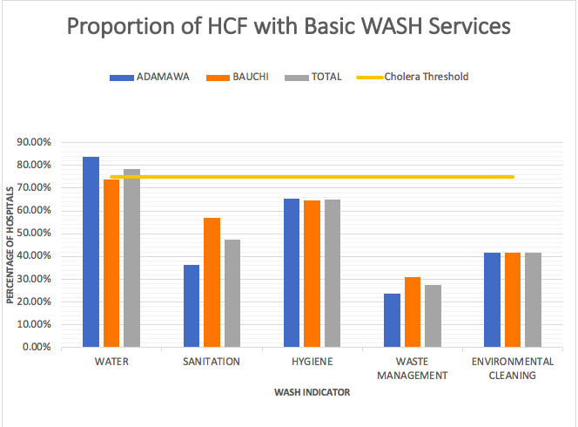
Preliminary Findings

Slide 9
Sources
1. Cholera in Africa [Internet]. Centers for Disease Control and Prevention. Centers for Disease Control and Prevention; 2020 [cited 2021 Dec 27]. Available from: https://www.cdc.gov/cholera/africa/index.html
2. Cholera [Internet]. World Health Organization. World Health Organization; 2021 [cited 2021 Dec 9]. Available from: https://www.who.int/news-room/fact-sheets/detail/cholera
3. Nigeria: Tackling the worst cholera outbreak in a decade [Internet]. Doctors Without Borders - USA. Medecins Sans Frontieres; 2021 [cited 2021Dec28]. Available from: https://www.doctorswithoutborders.org/what-we-do/news-stories/story/nigeria-tackling-worst-cholera-outbreak-decade
4. Cholera [Internet]. Cholera Fact Sheet. New York State Department of Health; 2017 [cited 2021 Dec 10]. Available from: https://www.health.ny.gov/diseases/communicable/cholera/fact_sheet.htm
5. Drop in cholera cases worldwide, as key endemic countries report gains in cholera control [Internet]. World Health Organization. World Health Organization; 2019 [cited 2021 Dec 10]. Available from: https://www.who.int/news/item/19-12-2019-drop-in-cholera-cases-worldwide-as-key-endemic-countries-report-gains-in-cholera-control
6. Cholera worldwide overview [Internet]. Surveillance and disease data. European Centre for Disease Prevention and Control; 2021 [cited 2021 Dec 10]. Available from: https://www.ecdc.europa.eu/en/all-topics-z/cholera/surveillance-and-disease-data/cholera-monthly
7. Huhn N. Cholera outbreak in Nigeria [Internet]. Outbreak Observatory. Outbreak Observatory; 2021 [cited 2021 Dec 10]. Available from: https://www.outbreakobservatory.org/outbreakthursday-1/7/29/2021/cholera-outbreak-in-nigeria
8. Ayenigbara IO, Ayenigbara GO, Adeleke RO. Contemporary Nigerian public health problem: prevention and surveillance are key to combating cholera. GMS Hyg Infect Control [Internet]. 2019 Oct;14(Doc16). Available from: https://www.ncbi.nlm.nih.gov/pmc/articles/PMC6838734/#R9
9. WHO supports Bauchi State to vaccinate over 700,000 persons with oral cholera vaccines during reactive campaign - nigeria [Internet]. ReliefWeb. OCHA; 2021 [cited 2021Dec28]. Available from: https://reliefweb.int/report/nigeria/who-supports-bauchi-state-vaccinate-over-700000-persons-oral-cholera-vaccines-during
10. Cholera vaccine information statement [Internet]. Centers for Disease Control and Prevention. Centers for Disease Control and Prevention; 2019 [cited 2021 Dec 10]. Available from: https://www.cdc.gov/vaccines/hcp/vis/vis-statements/cholera.html
11. Core questions and indicators for monitoring WASH in health care facilities in the Sustainable Development Goals. Geneva; 2018 [cited 2021 Dec 10]. Available from: https://www.who.int/publications/i/item/9789241514545
12. Elimian K, King C, Diaconu K et al. Understanding the factors enabling and blocking sustained implementation of cholera interventions in a fragile region of Nigeria: a multi-phase group model building study protocol [version 1; peer review: 2 approved with reservations]. F1000Research 2021; 10:85. Available from: https://doi.org/10.12688/f1000research.50831.1
13. Africa [Internet]. Population Statistics, Maps, Charts, Weather and Web Information. City Population; [cited 2021Dec28]. Available from: https://citypopulation.de/Nigeria-Cities.html
14. 2019 Poverty and Inequality in Nigeria: Executive Summary [Internet]. 2020May [cited 2021Dec27]; Available from: https://nigerianstat.gov.ng/elibrary/read/1092
15. Makinde OA, Sule A, Ayankogbe O, Boone D. Distribution of health facilities in Nigeria: Implications and options for Universal Health Coverage. The International Journal of Health Planning and Management [Internet]. 2018;33(4). Available from: https://onlinelibrary.wiley.com/doi/epdf/10.1002/hpm.2603?saml_referrer

